Slide 1
Developing Student-Run Businesses as a Stepping Stone to Employer-Paid Jobs
Presented By: Corey Fineran & Lindsay Zerull
Transition Curriculum, Inc
NextUp Transition Curriculum

Slide 2
Student-Run Businesses
What is a student-run business?
A micro-enterprise within the school building or classroom that provides an entrepreneurial experience for students developing transition skills needed for post-secondary employment and living.
Why should schools create this opportunity for students?
Increases labor force participation
Enhancement of students’ understanding and engagement.
Skill development (soft skills, hard skills, communication, self-determination)

Slide 3
Examples
Products
Themed Clothing
Coffee Shop
Food Items
Greeting Cards
Handmade Products
Agriculture (Flowers or Plants)
Digital Products
Services
Recycling
Copying
Cleaning/Laundering
School Events
Notes:
School events – ticketing, general assistance ?

Slide 4
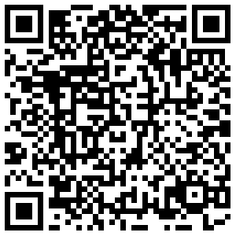
Evaluate
Research business ideas
Identify the target market
Determine the internal strengths/weaknesses and the external opportunities and threats
Determine start-up costs
Evaluate students’ ability and determine supports
Analyze environmental and location factors
NextUp Student-Run
Business Set-Up:

Slide 5
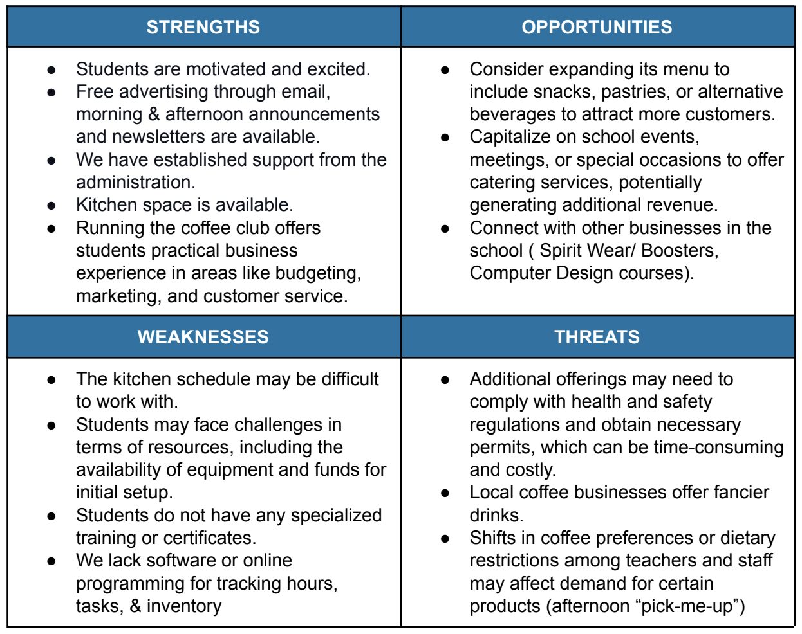
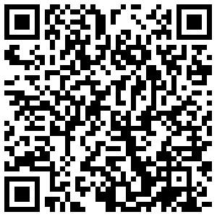
Sample SWOT Analysis

Slide 6
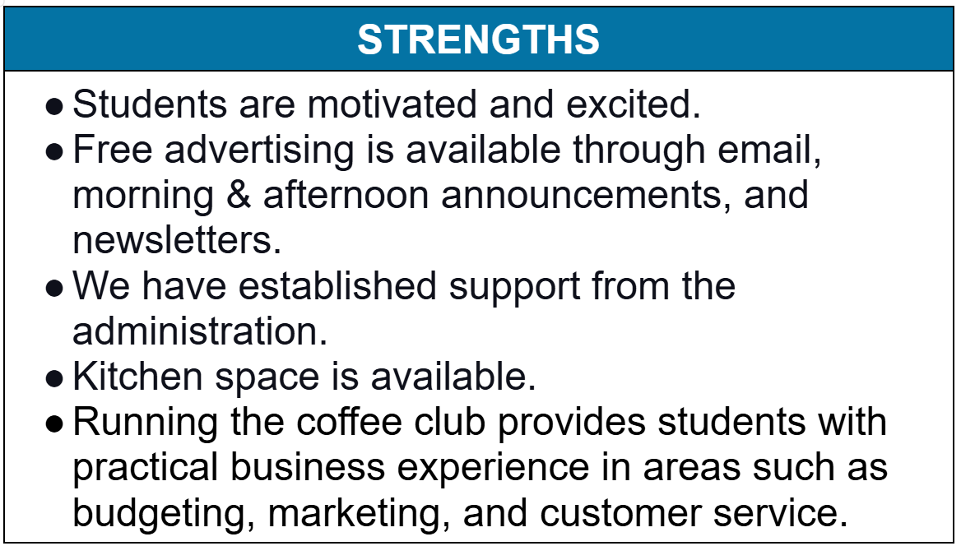
Sample SWOT Analysis

Slide 7
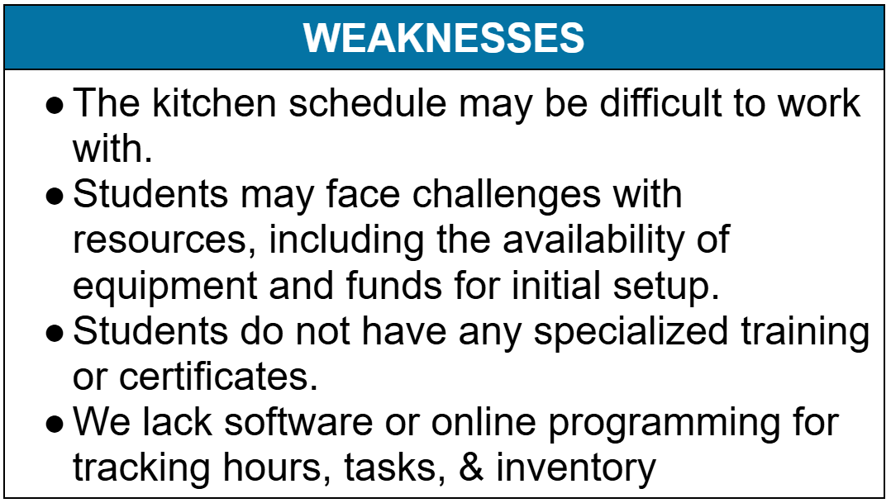
Sample SWOT Analysis

Slide 8
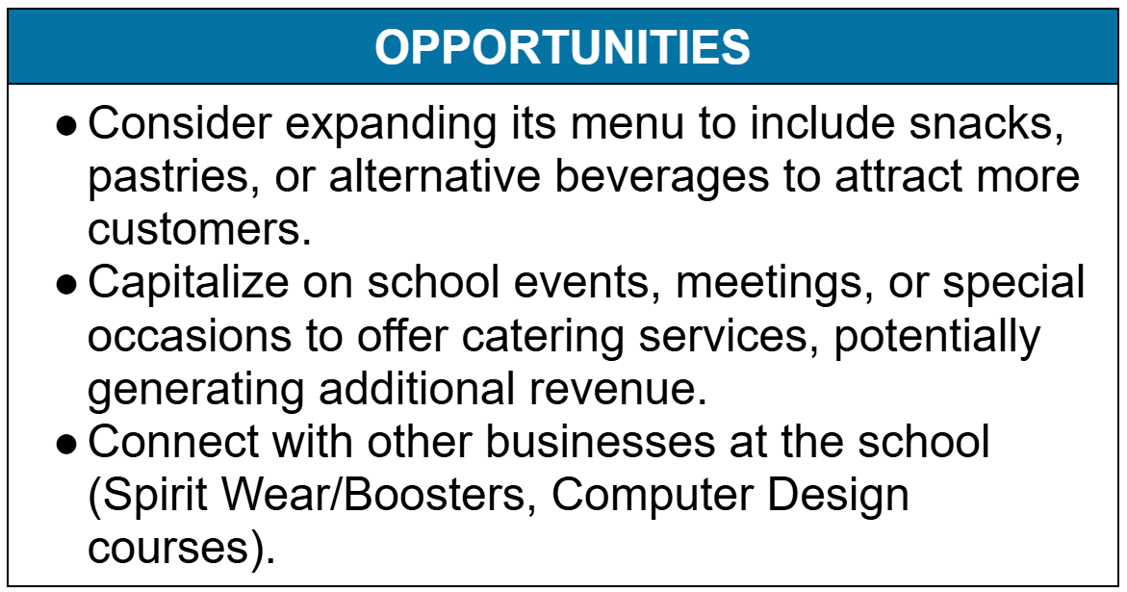
Sample SWOT Analysis

Slide 9
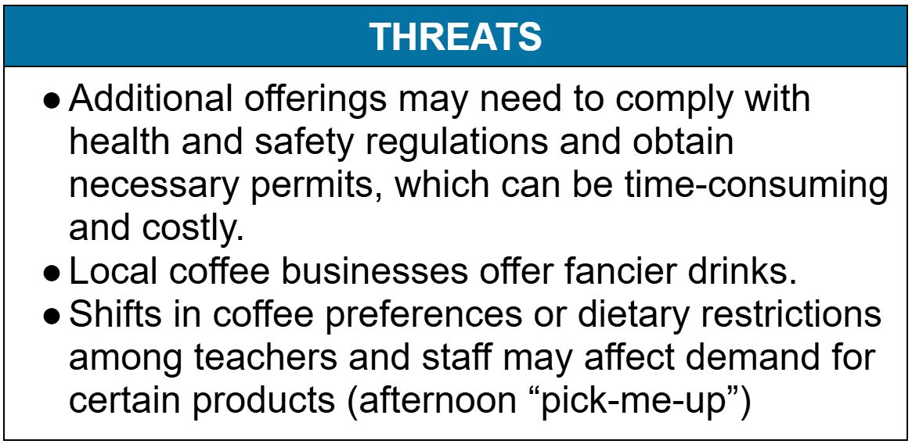
Sample SWOT Analysis

Slide 10
Support
Gain key support by engaging students, parents, staff, administrators, and the community
Student involvement in all areas is crucial
Fundraising efforts, pitching ideas to stakeholders
Highlight how this will benefit the students, staff, school, and community
Opportunity to build relationships with local businesses for future job development

Slide 11
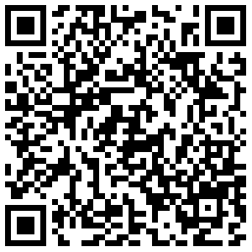
Business Plan
Name & Logo
Identifies sales tactics
Encourages collaboration, leadership, and critical thinking
Business Mission
Develops a shared vision
Helps students set meaningful goals
Roles & Responsibilities
Promotes identifying workplace strengths
Encourages teamwork
Promotion
Develops real-world marketing and communication skills
Pricing
Builds financial literacy
Helps determine profit utilization
Notes:
Added – financial projections

Slide 12
Determine Roles
Assign Roles for Efficiency & Growth
Helps students understand responsibilities and expectations
Create Job Descriptions
Define roles clearly and precisely
Provides real-world pre-employment experience
Application & Interview Process
Students review job descriptions and apply for positions
Include administrators, business leaders, or community members
Simulating Workplace Procedures
Complete new-hire paperwork (tax forms, employment agreements)
Sign workplace rules – just like a real job

Slide 13
Market
Marketing Strategies
Flyers, posters, email promotions, newsletters, and school announcements.
Partner with student-run social media teams
Collaboration Opportunities
Work with students outside of transition/special education programs
Leveraging Local Media
Radio and TV stations love positive community stories
Great for showcasing student skills and workforce preparation

Slide 14
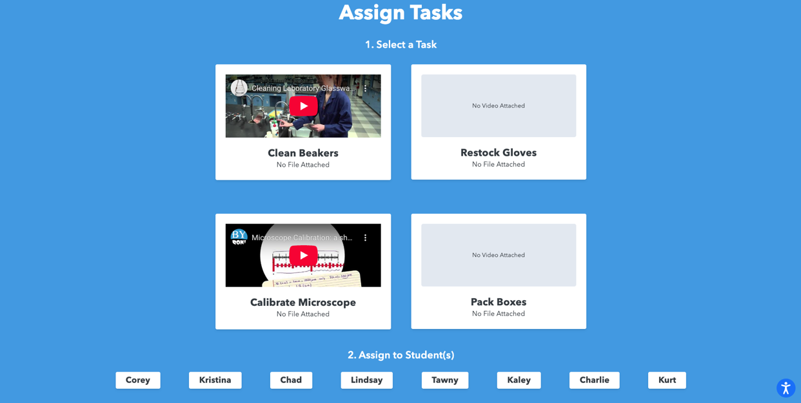
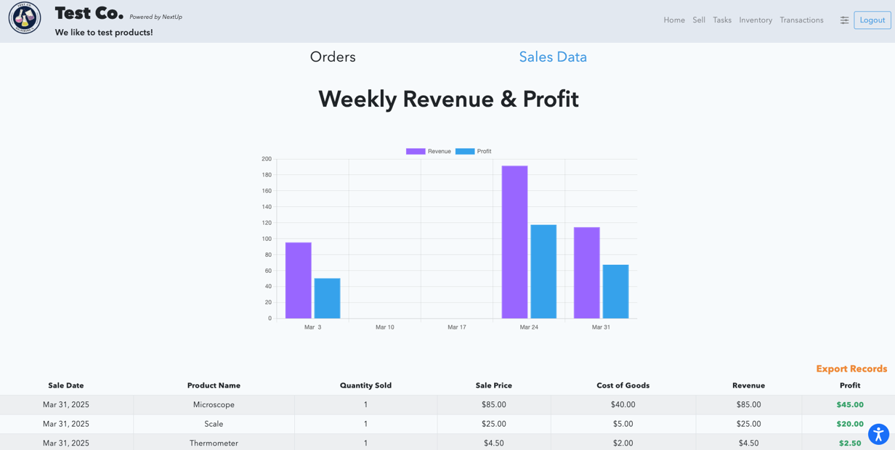
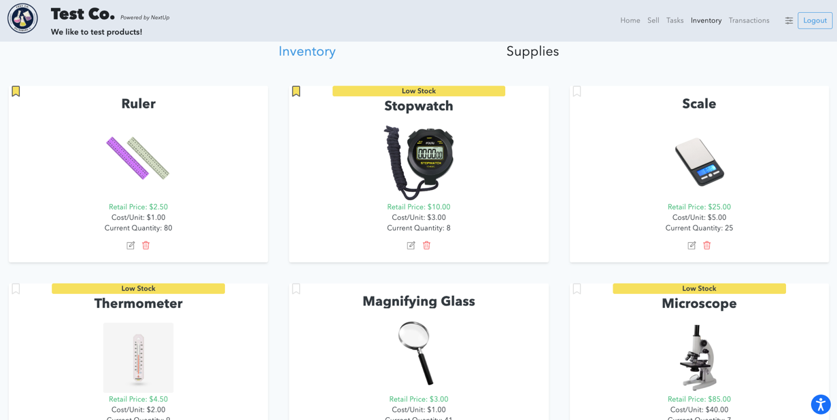
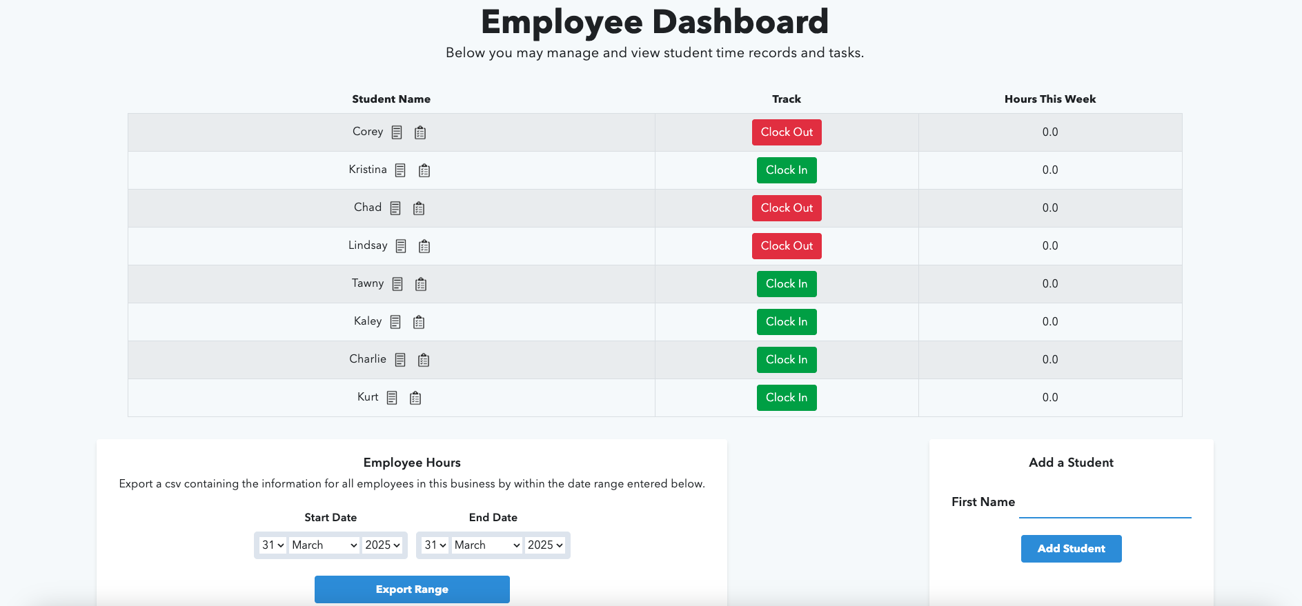
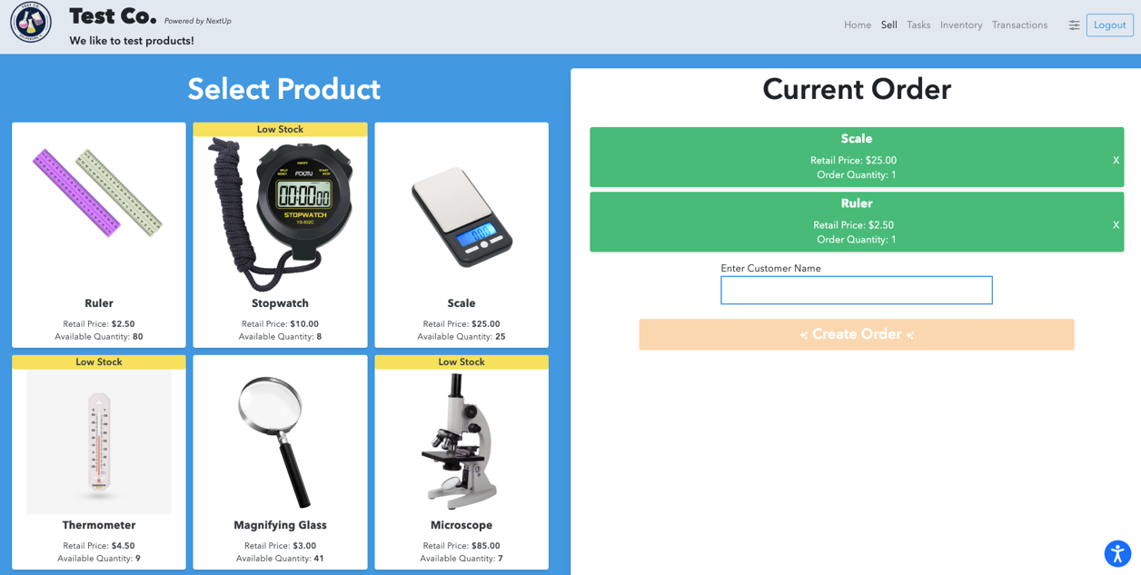
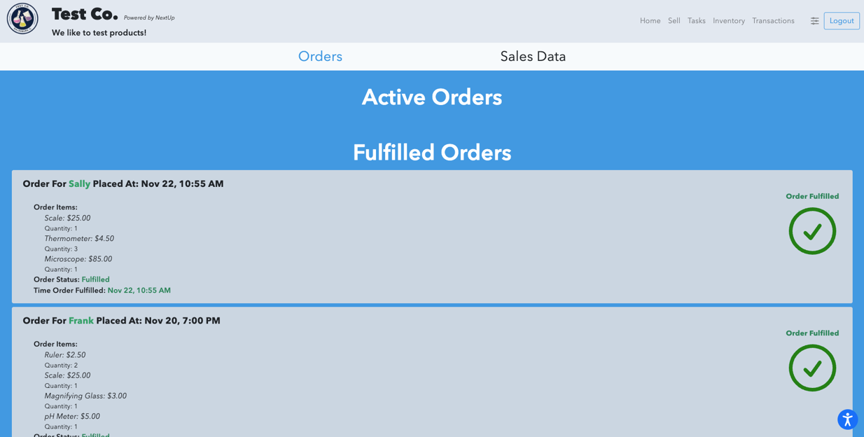
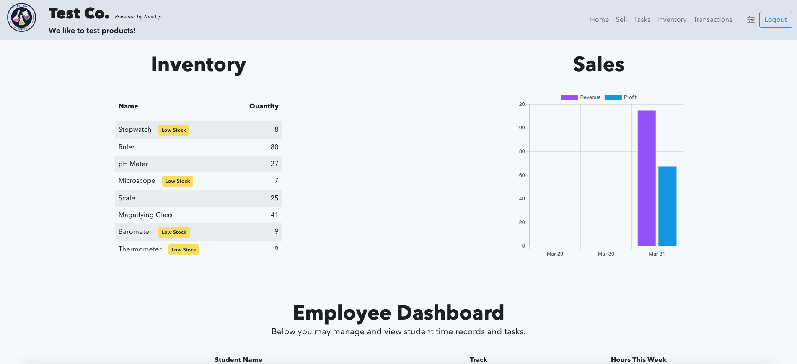

Slide 15
Teaching Opportunities
Academic and Career Readiness Integration
Align with academic learning standards
Create opportunities to support financial literacy, business etiquette, and pre-employment skills
Assessing Student and Business Success
Gather consumer feedback
Utilize employee evaluations
Integrate annual IEP goals
Encourage self-evaluation and goal-tracking
Data Collection & Long-Term Impact
Leverage post-school outcomes
Utilize tracking systems for hours, tasks, inventory, and sales
Notes:
Added “interviews”

Slide 16
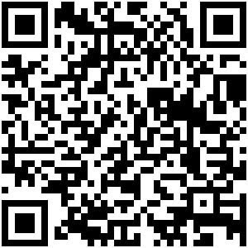
Thank you for attending!
Corey Fineran - corey.fineran@transitioncurriculum.com
Lindsay Zerull – lindsay.zerull@transitioncurriculum.com
TransitionCurriculum.com/conference

